Slide 1



React Internals & Props
Ragav kumar V
@ragavkumarv

Slide 2
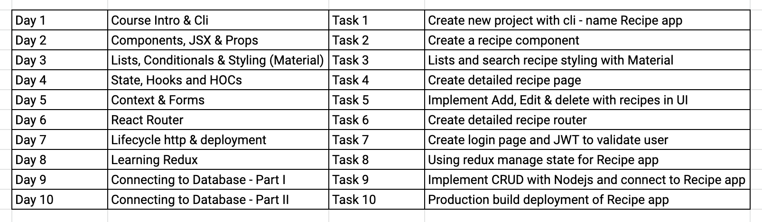

Slide 3
State of Web - Before React

Slide 4
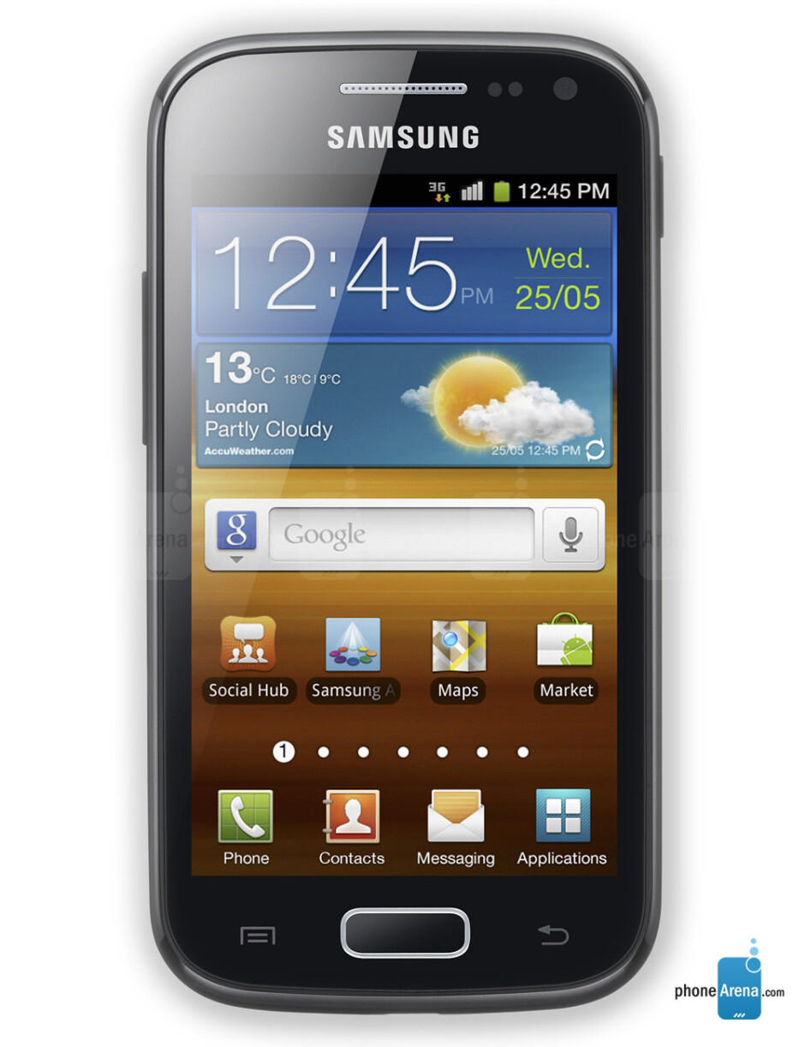
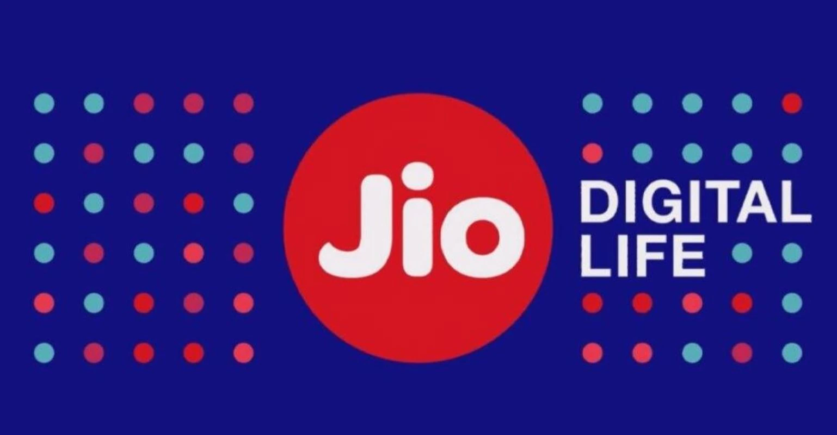
Tech Advancement?

Slide 5
Before vs After
Call rate cutter
SMS pack
Internet pack
Roaming charge
….
Only one pack - ₹349

Slide 6
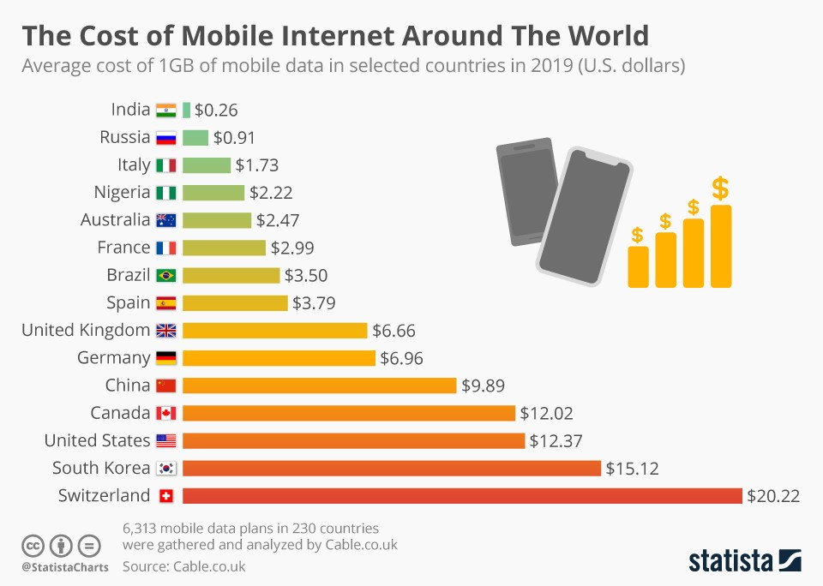

Slide 7
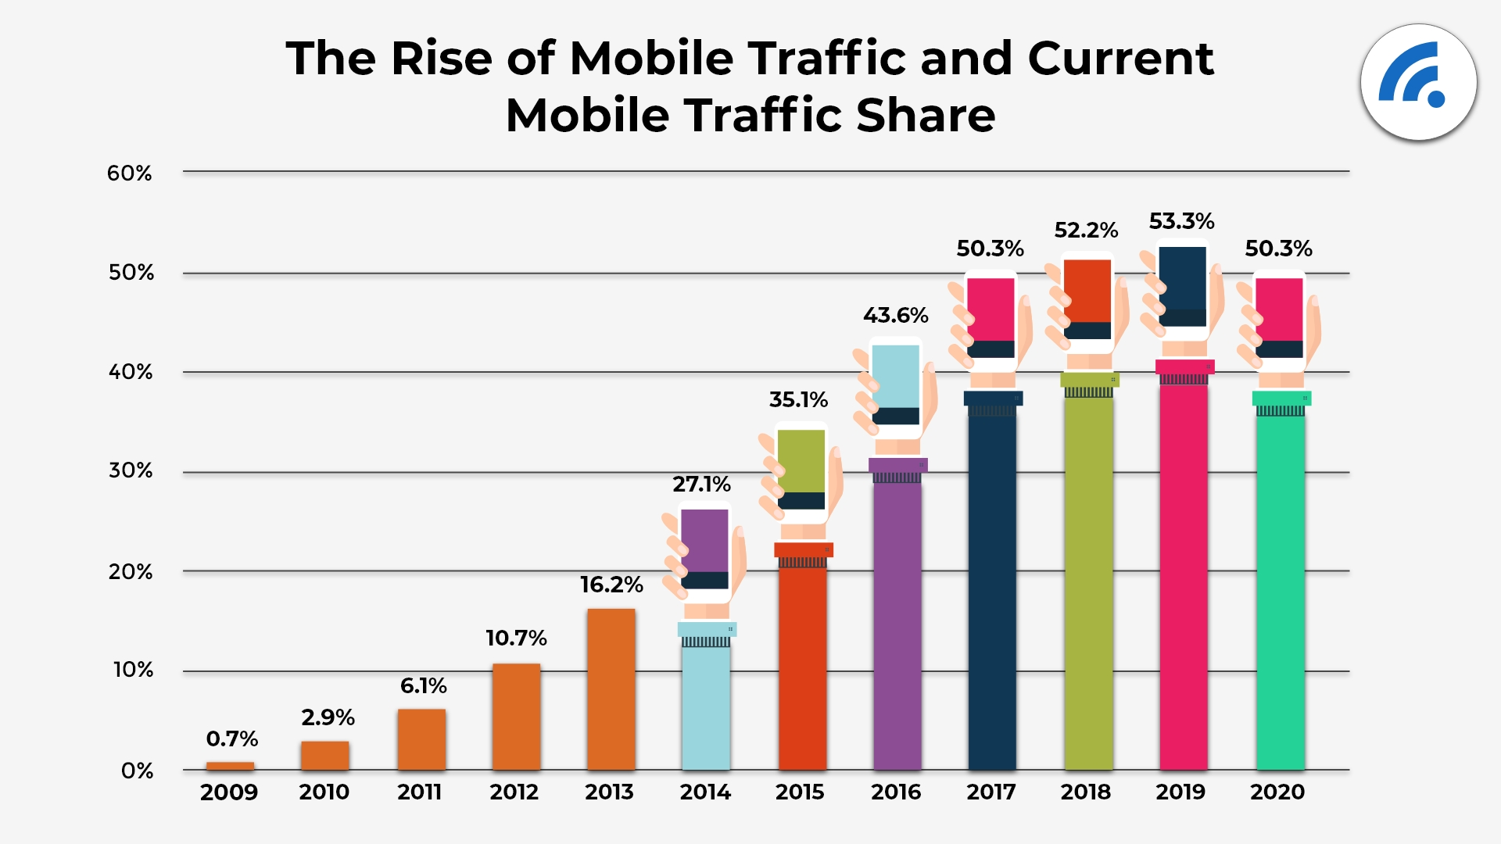

Slide 8
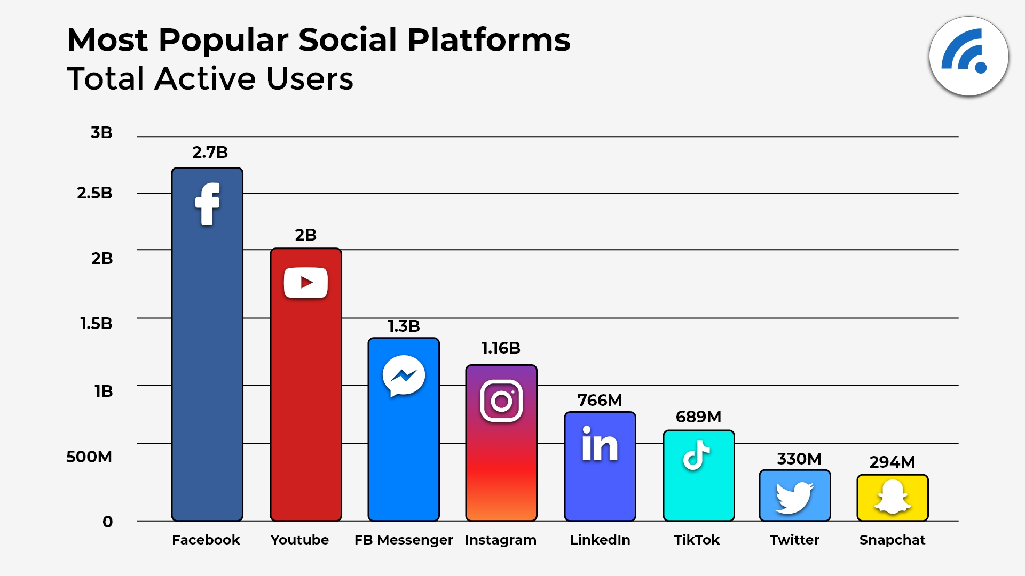

Slide 9

Effects
Drop in barrier to entry to the Internet
Huge mobile traffic
Huge Business opportunity

Slide 10
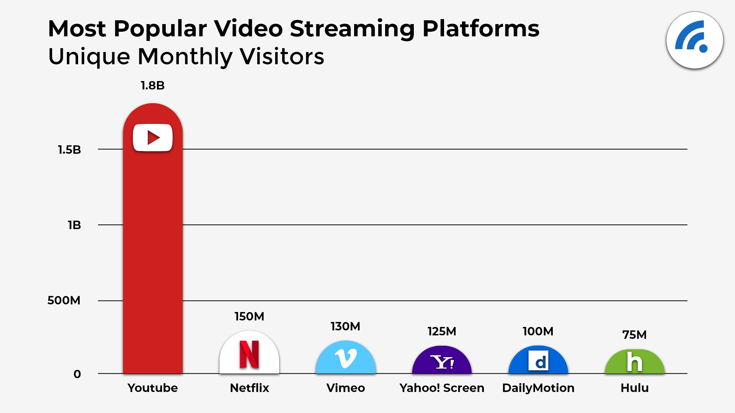

Slide 11
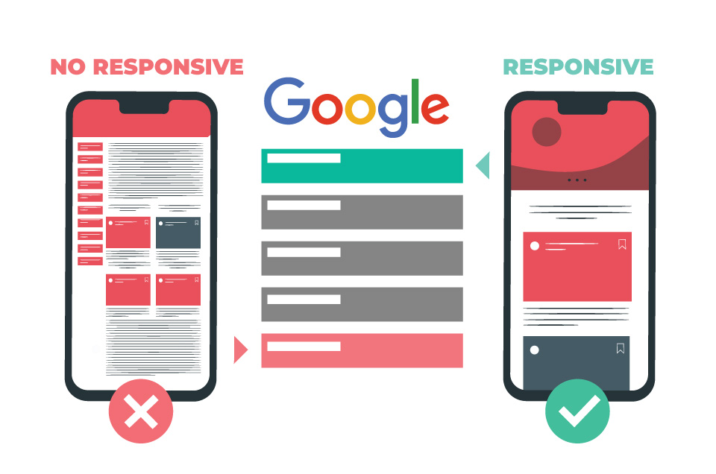

Slide 12
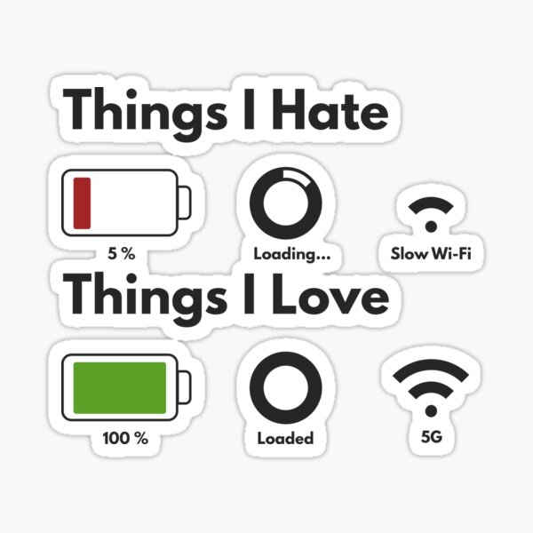


Slide 13
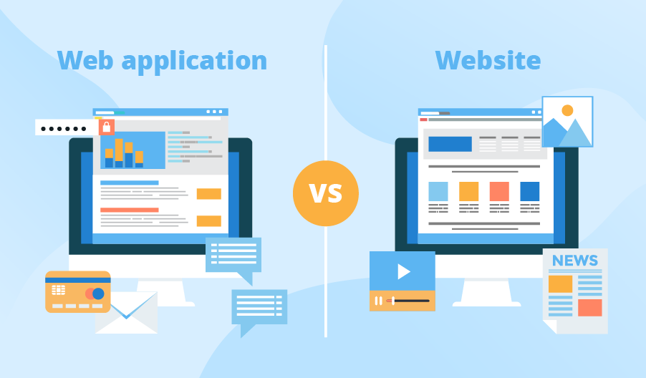

Slide 14








Translator/ Compiler

Slide 15
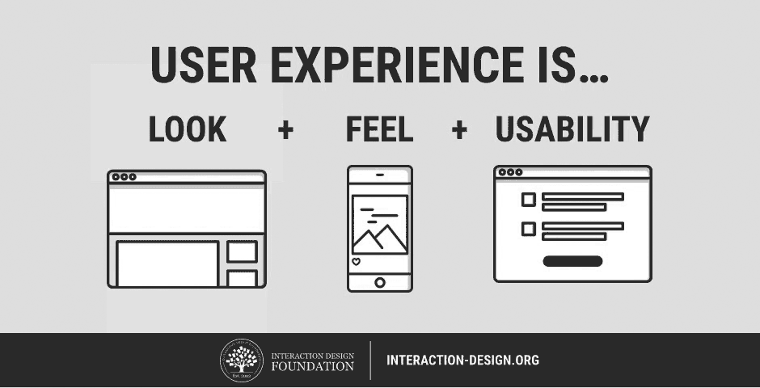

Slide 16
React

Slide 17
Features of React

Slide 18
SPA

Slide 19
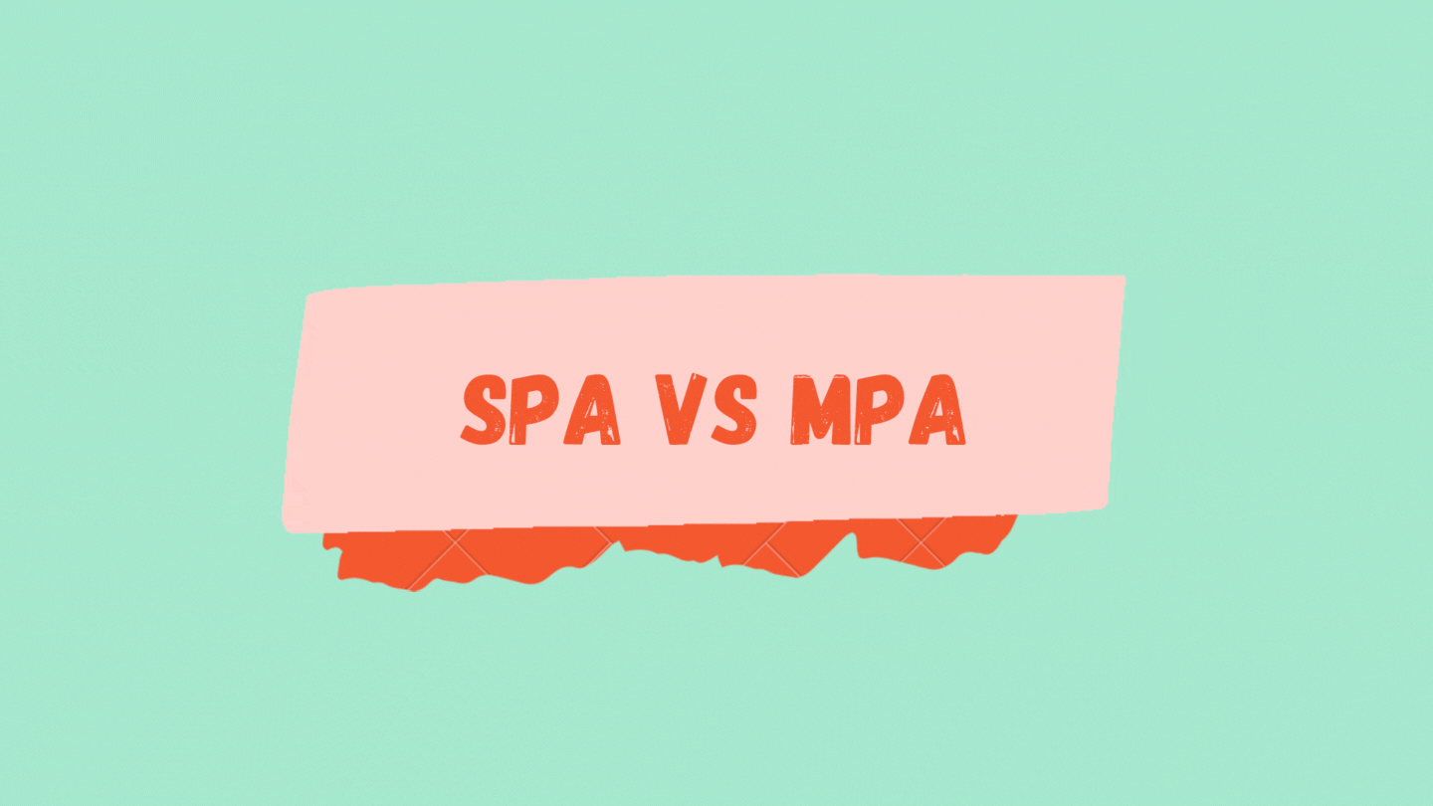

Slide 20
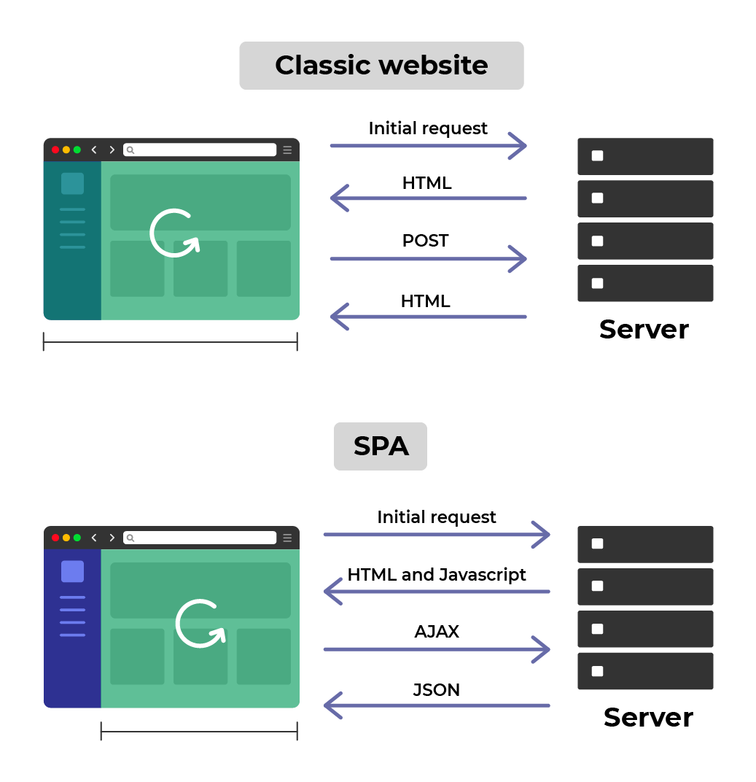

Slide 21
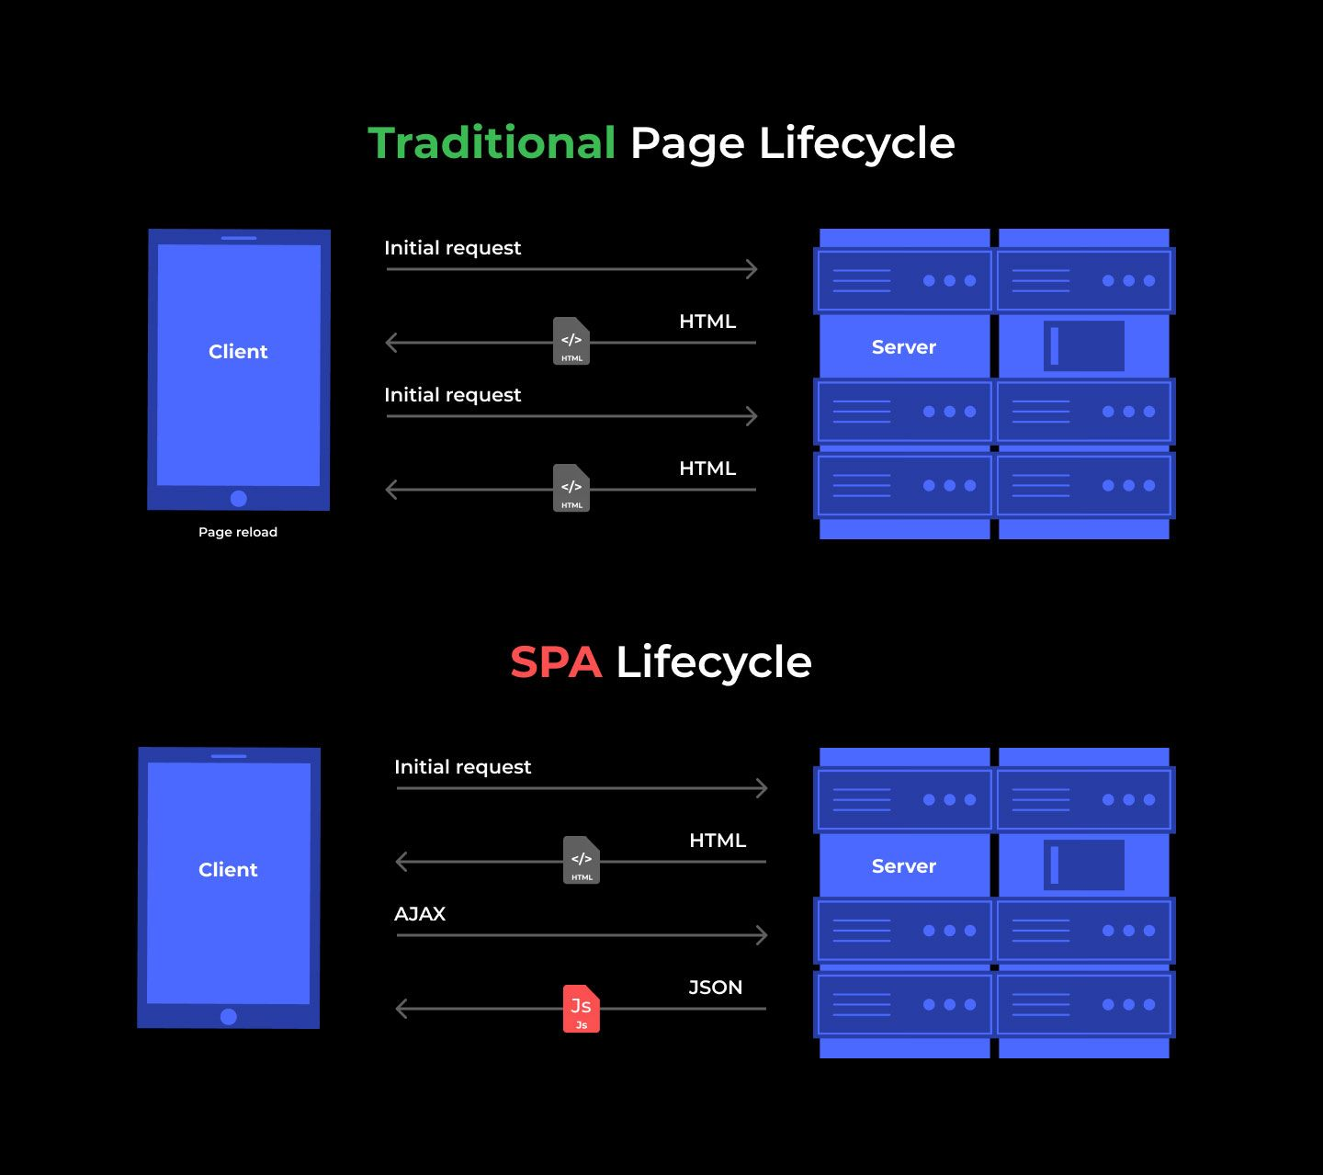

Slide 22
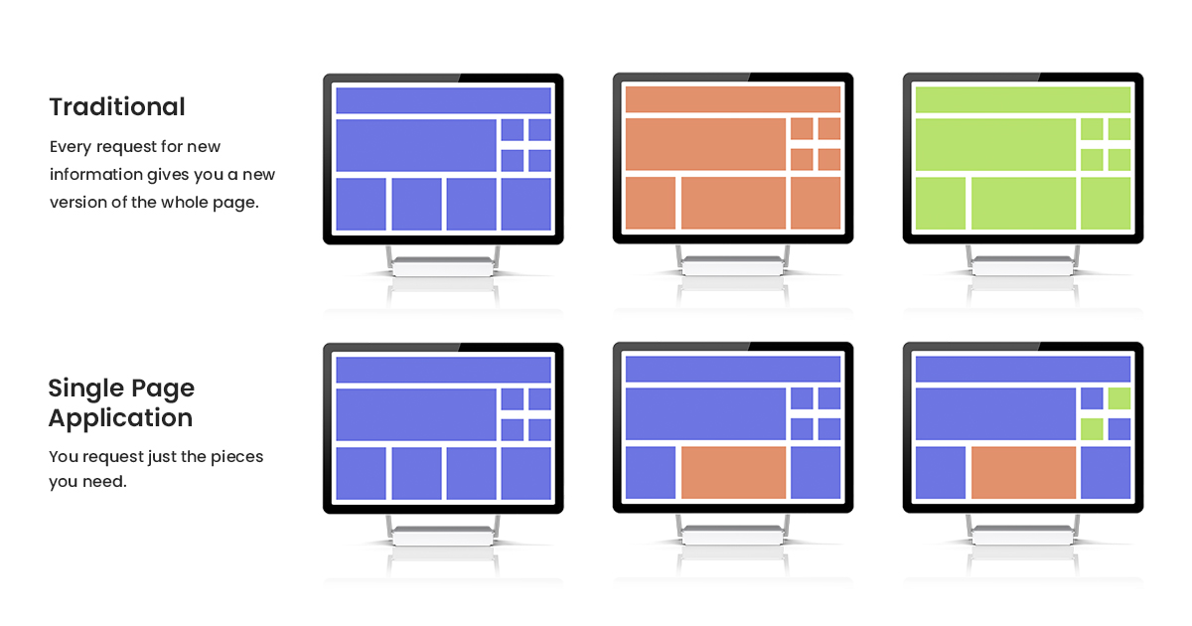

Slide 23
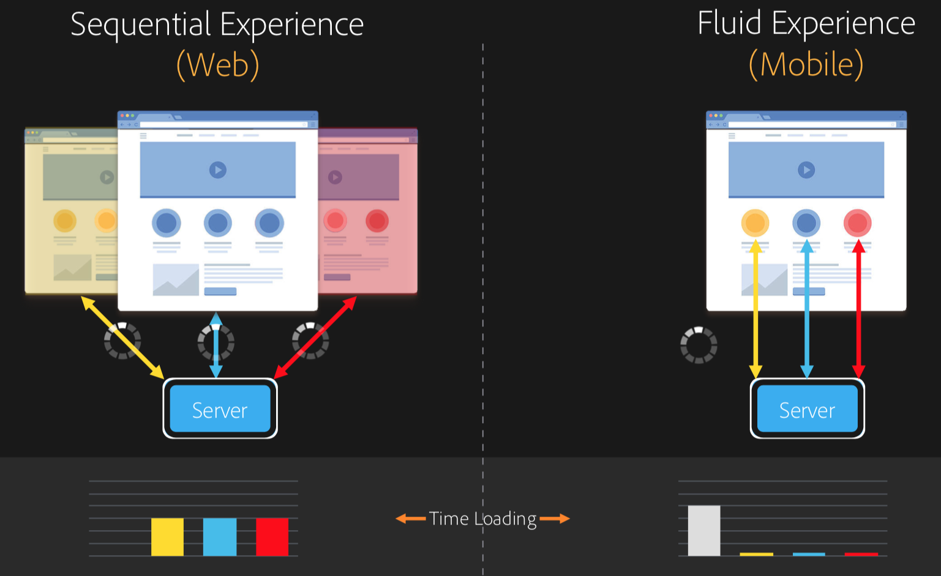

Slide 24
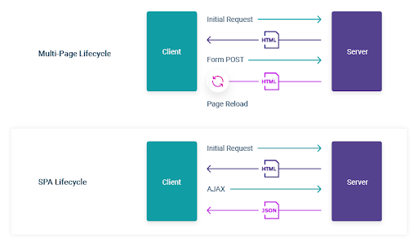

Slide 25
MPA - Live example
https://retail.onlinesbi.com/personal/tax_retail.html

Slide 26
SPA - examples

Slide 27
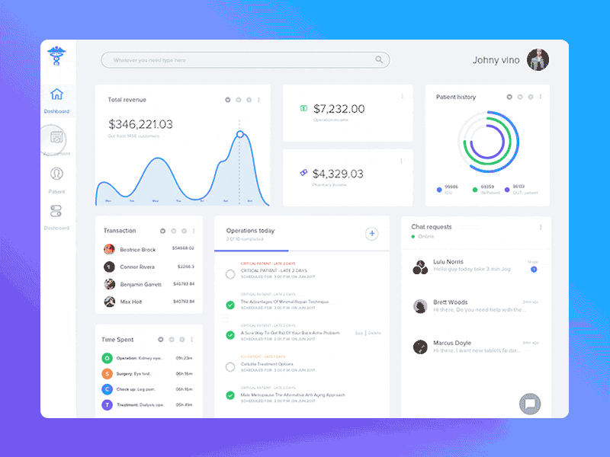

Slide 28
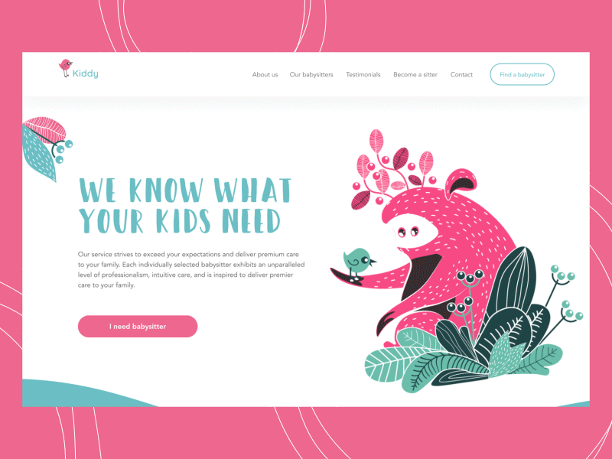

Slide 29
Advantages of SPA
Smooth performance
No refresh
Data saving - Better caching

Slide 30
Reusability

Slide 31
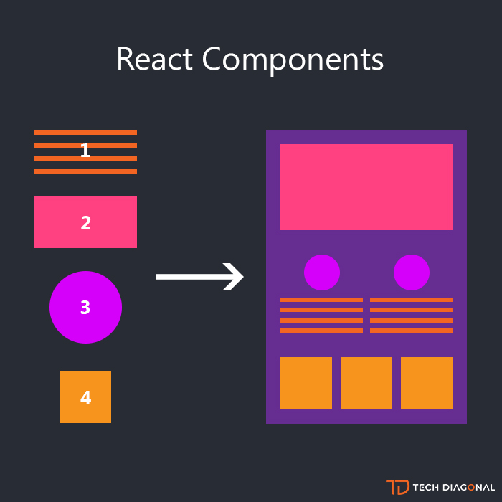

Slide 32
Components
Mix of HTML, CSS, JS

Slide 33
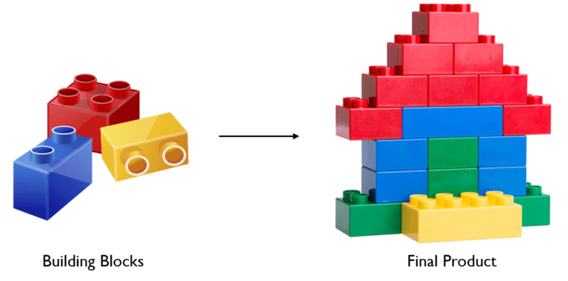

Slide 34
Codesanbox - setup

Slide 35
<noscript></noscript>

Slide 36
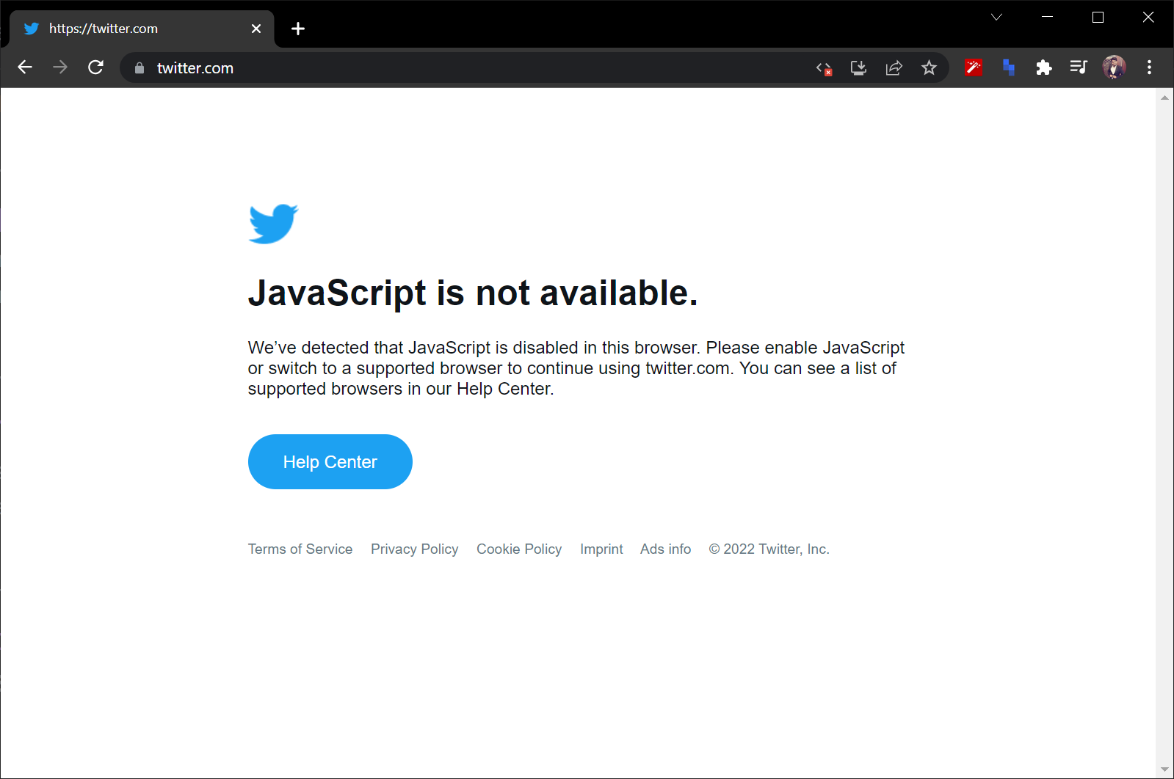

Slide 37
Disable JS
chrome://settings/content/javascript

Slide 38
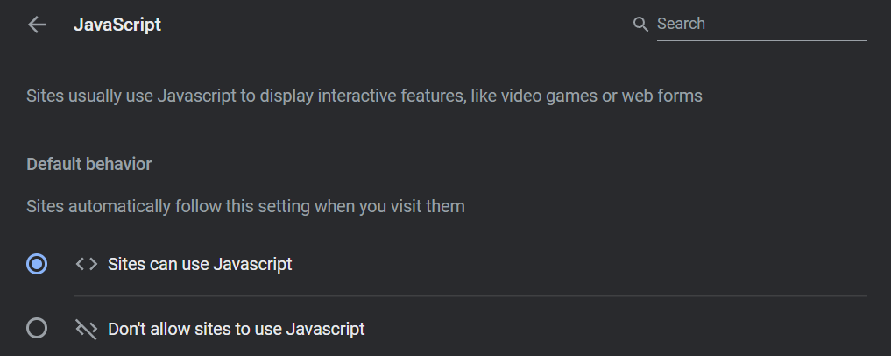

Slide 39
Why disable JS?
Historically for performance
Avoid Ads
Pure reading heaven - eg: medium.com, hindu.com

Slide 40
Virtual Dom

Slide 41
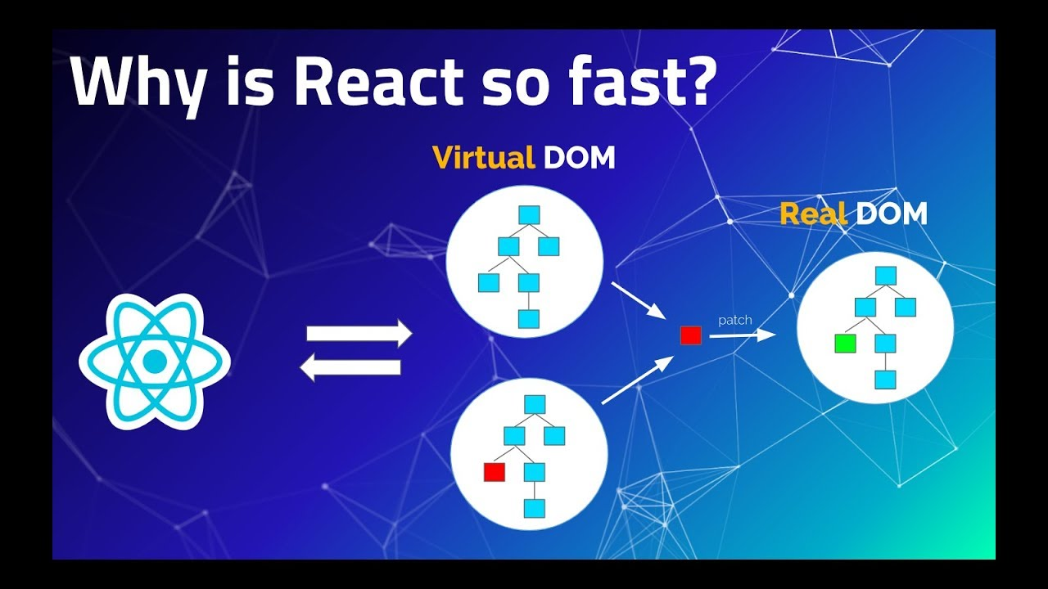

Slide 42
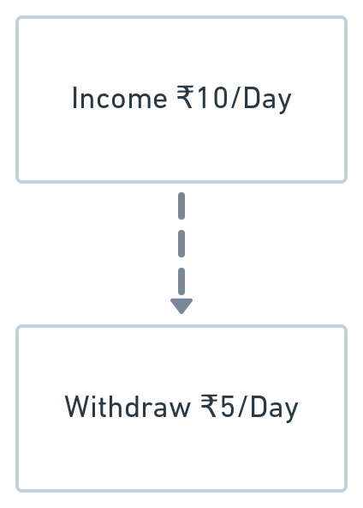

Slide 43
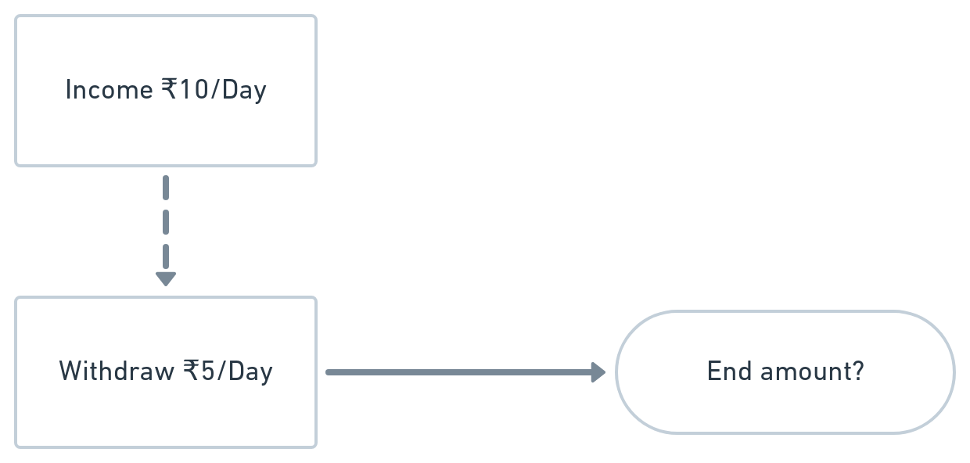

Slide 44
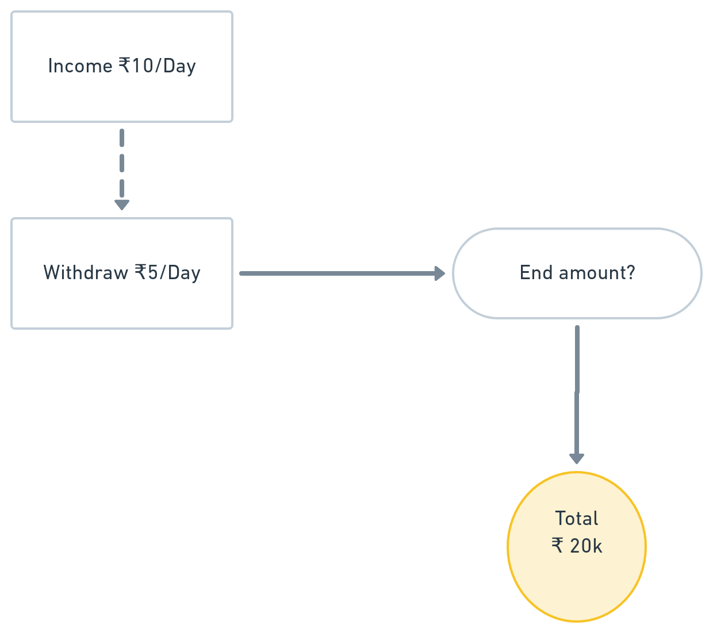

Slide 45
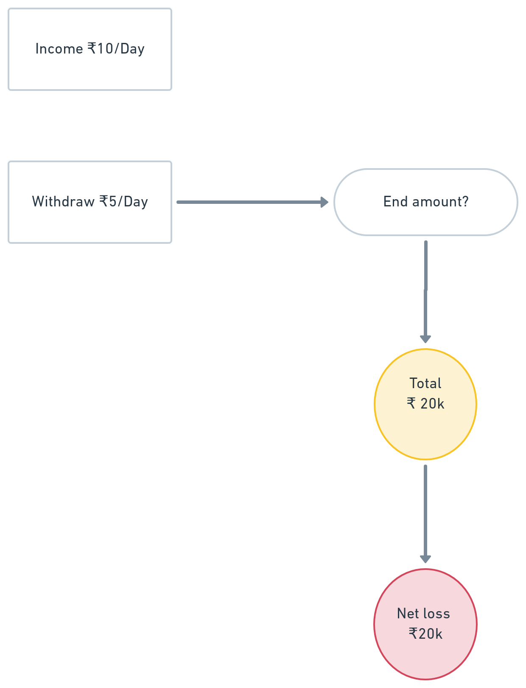

Slide 46
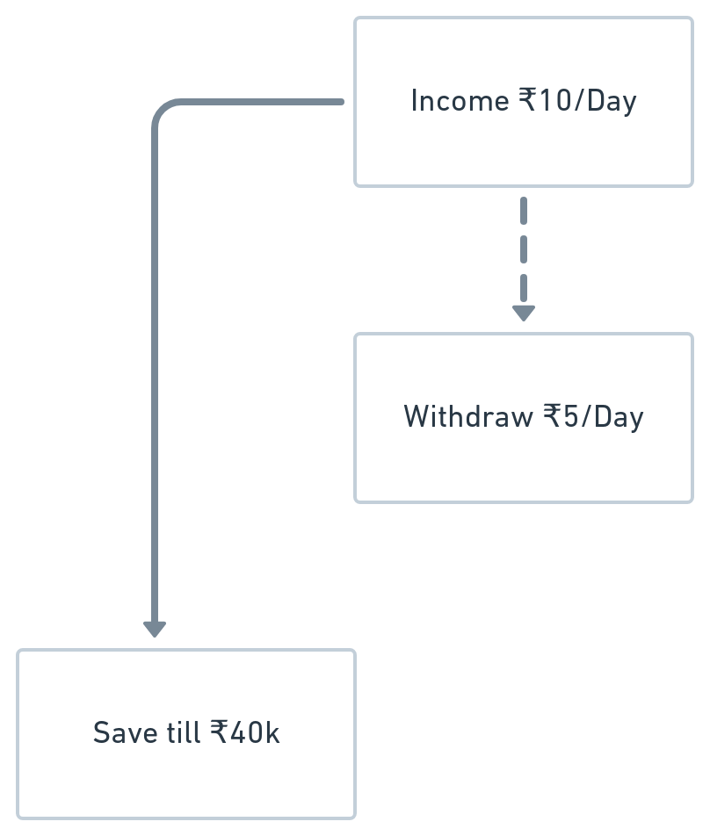

Slide 47
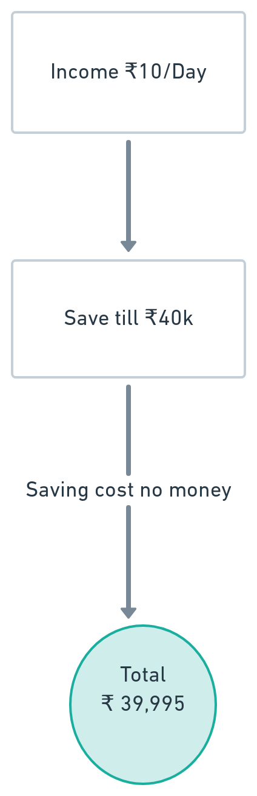

Slide 48
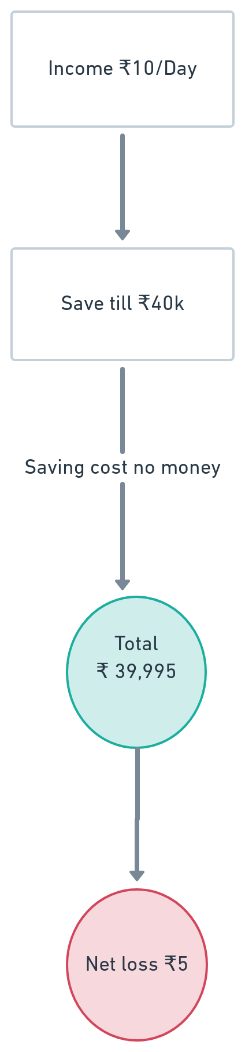

Slide 49
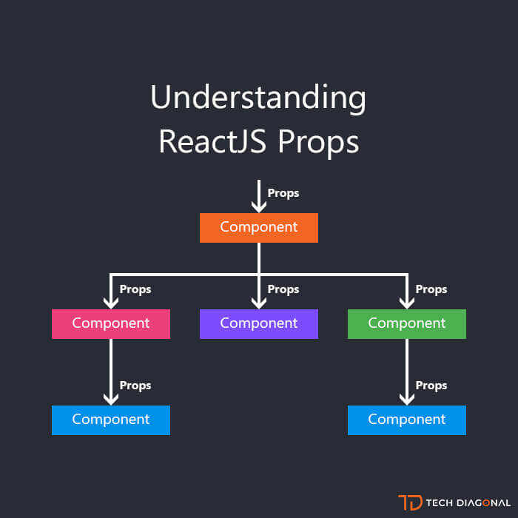

Slide 50
Thank you

